Slide 1
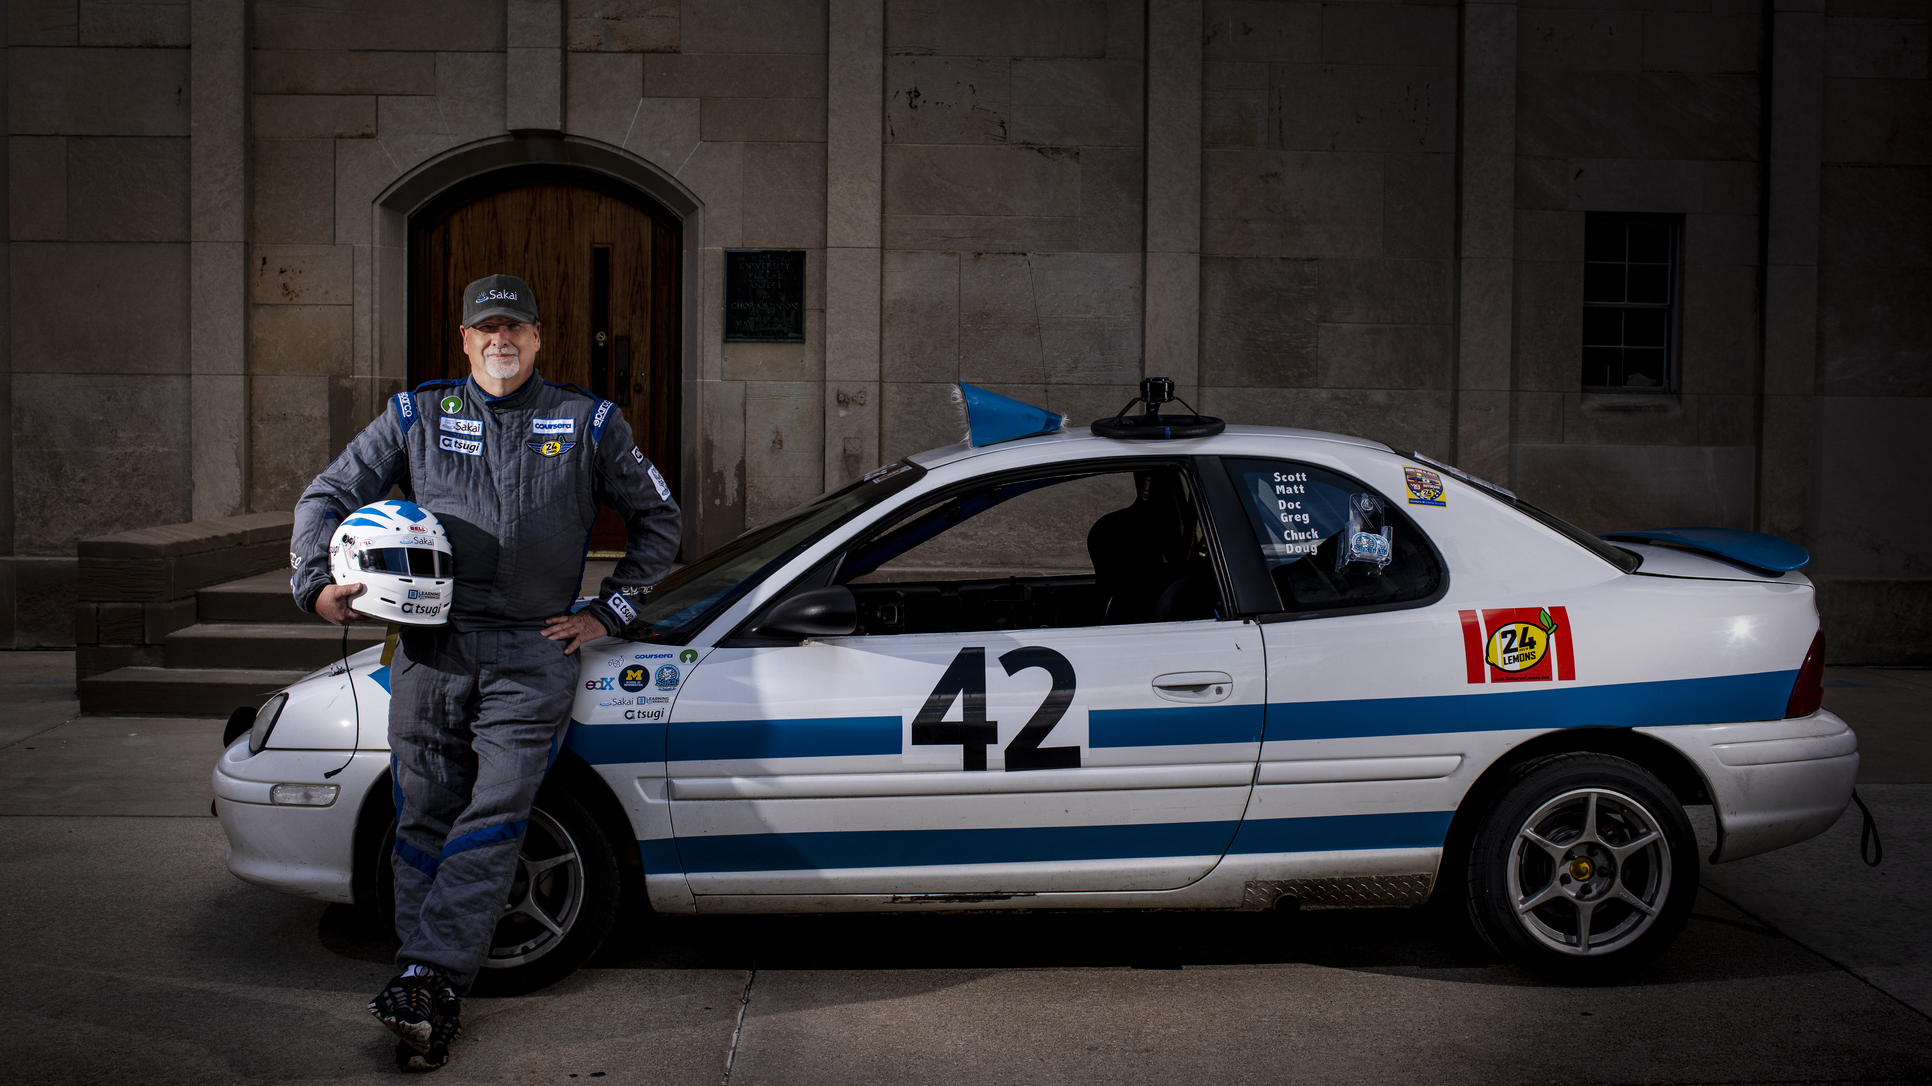
PostgreSQL for Everybody
Charles R. Severance
www.pg4e.com
Photo: Jeffrey Smith

